Slide 2
Image Stitching

Slide 3
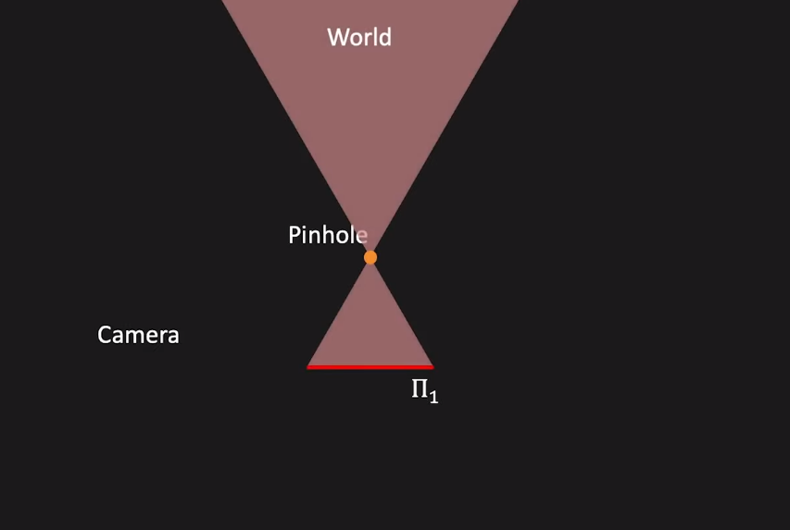
Homography Composition

Slide 4
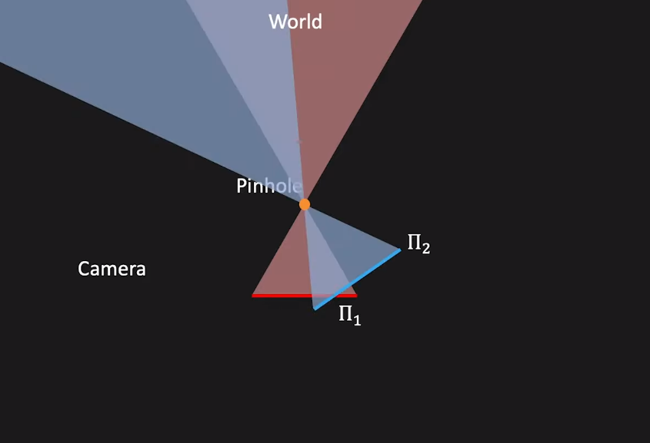
Homography Composition

Slide 5
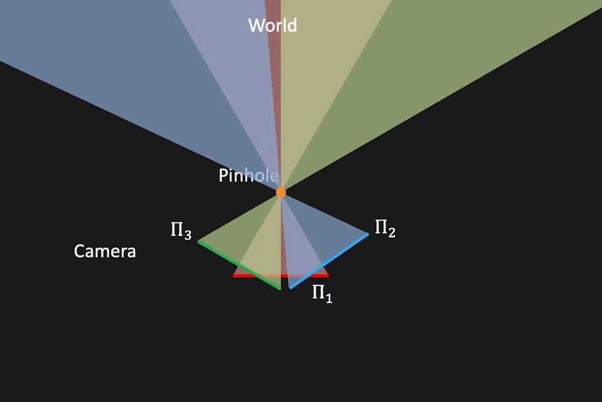
Homography Composition

Slide 6
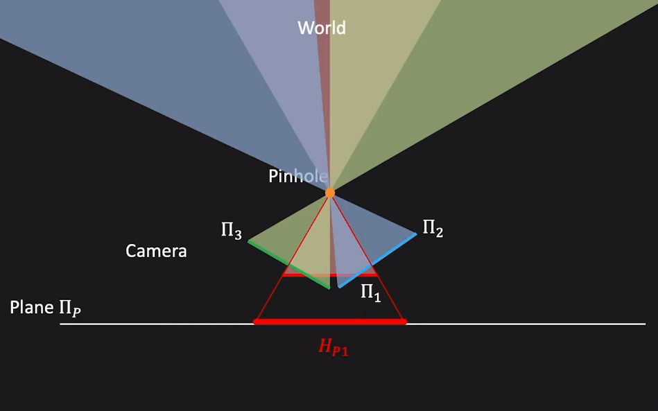
Homography Composition

Slide 7
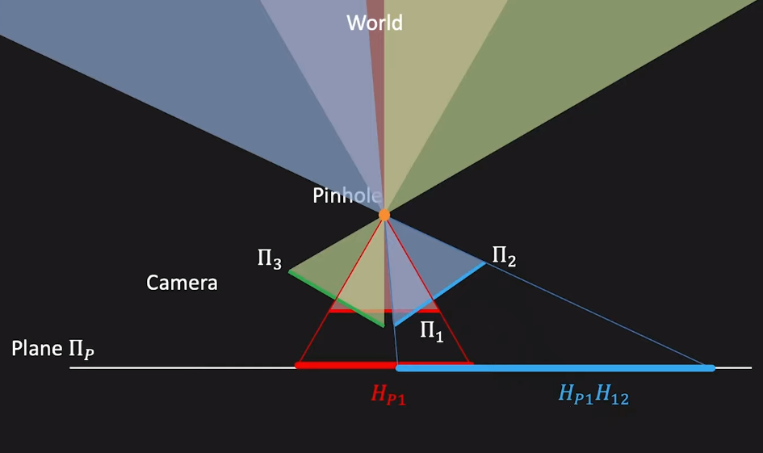
Homography Composition

Slide 8
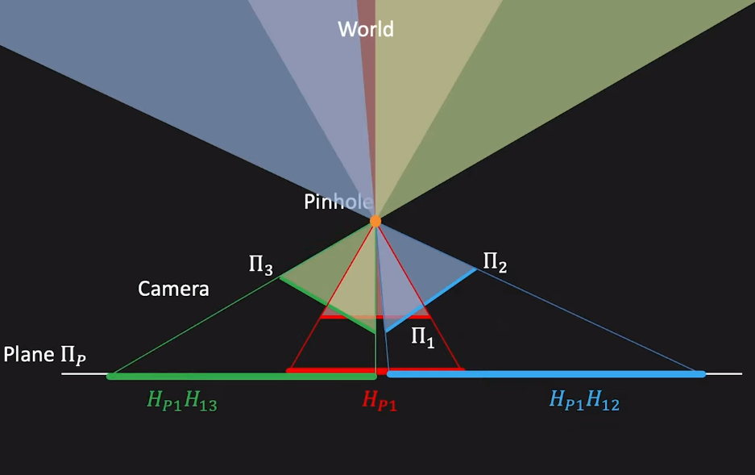
Homography Composition

Slide 9
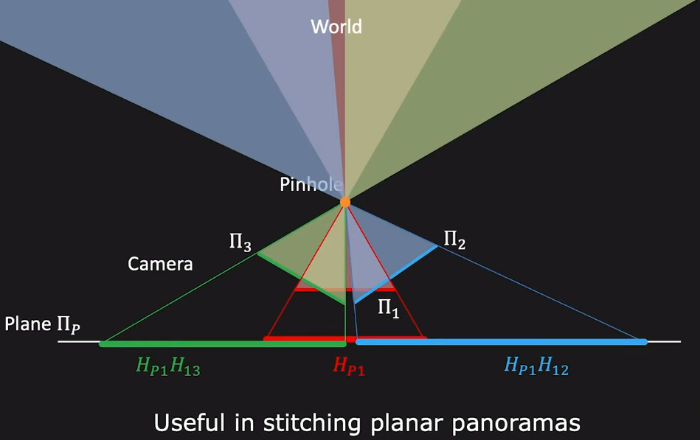
Homography Composition

Slide 10
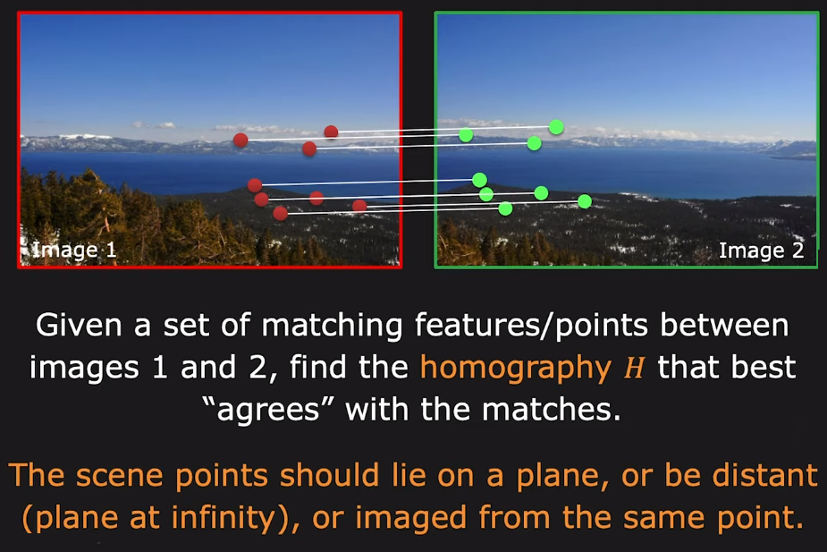
Computing Homography

Slide 11
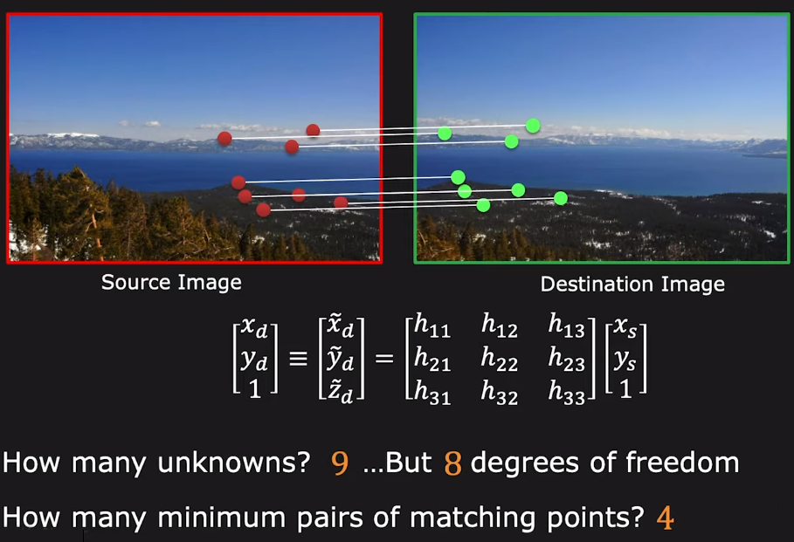
Computing Homography

Slide 12
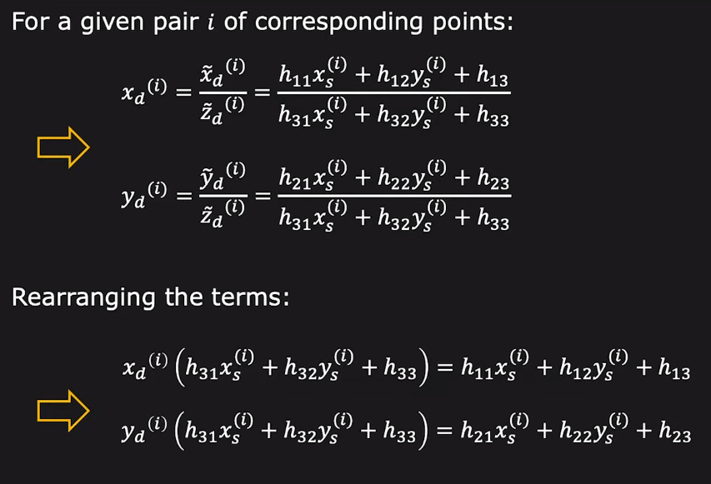
Computing Homography

Slide 13
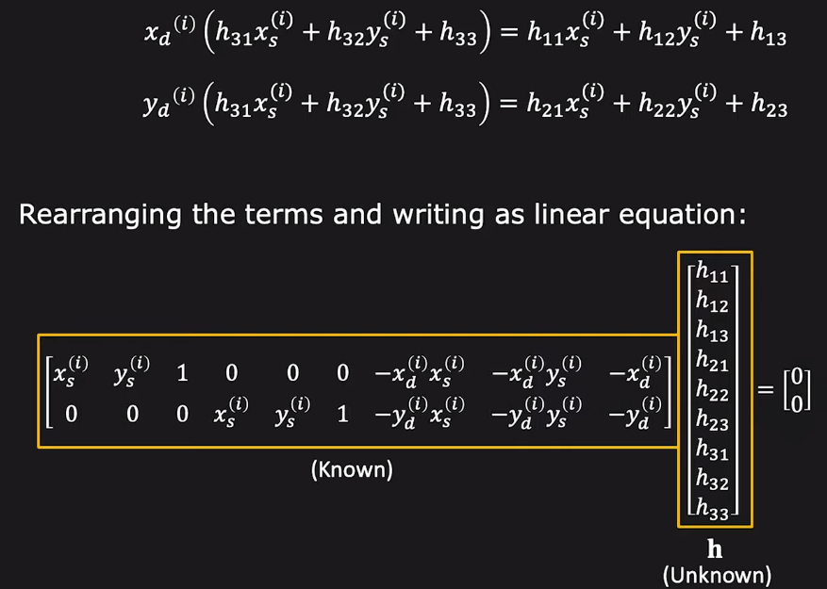
Computing Homography

Slide 14
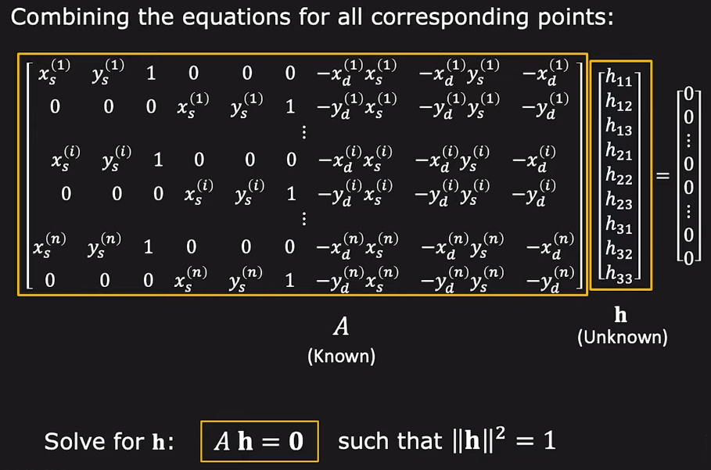
Computing Homography

Slide 15
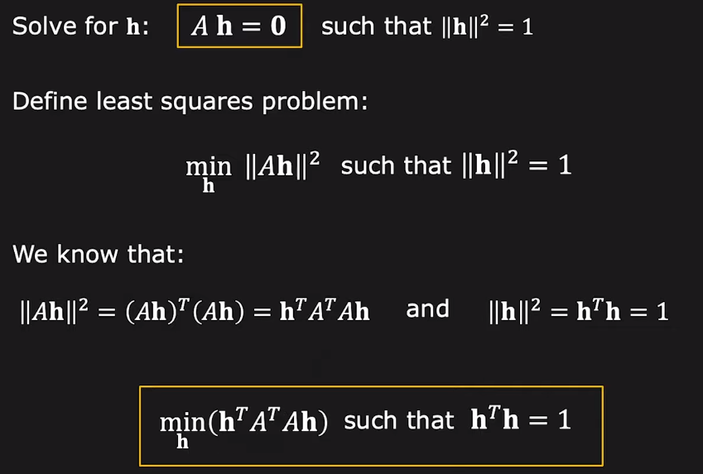
Computing Homography

Slide 16
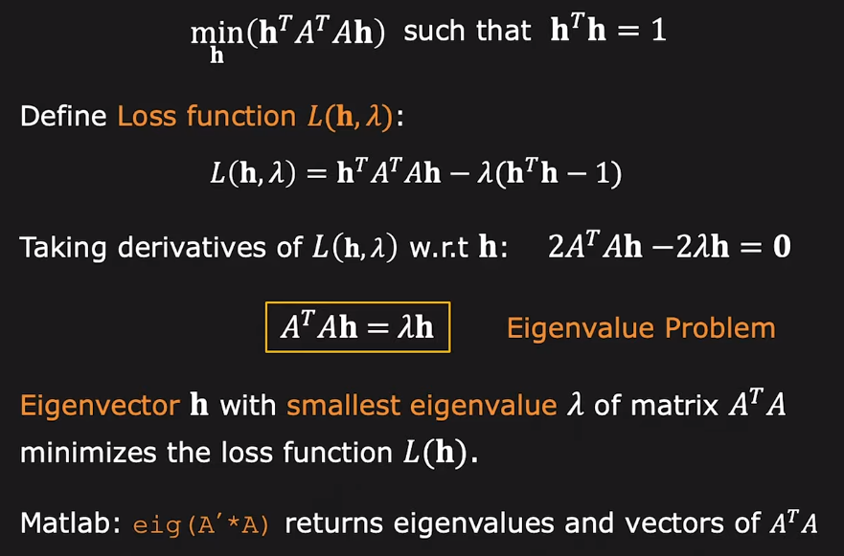
Computing Homography

Slide 17
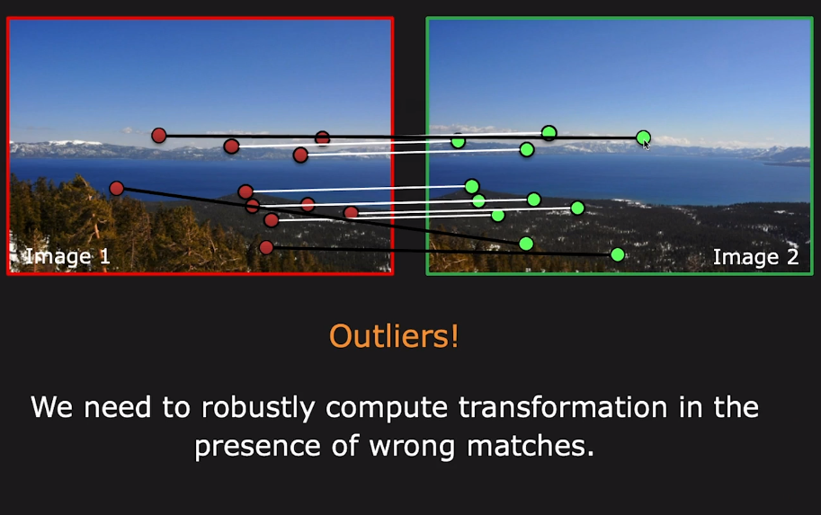
What Could Go wrong ?

Slide 18
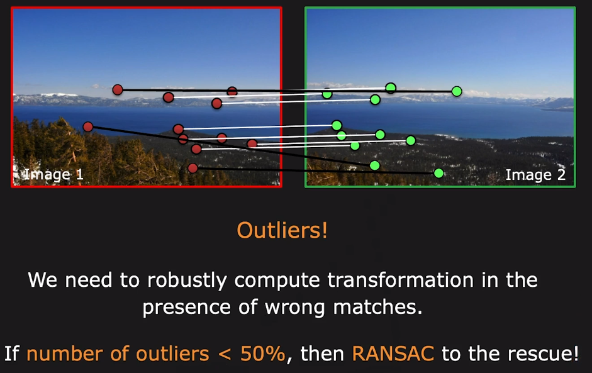
RANSAC

Slide 19
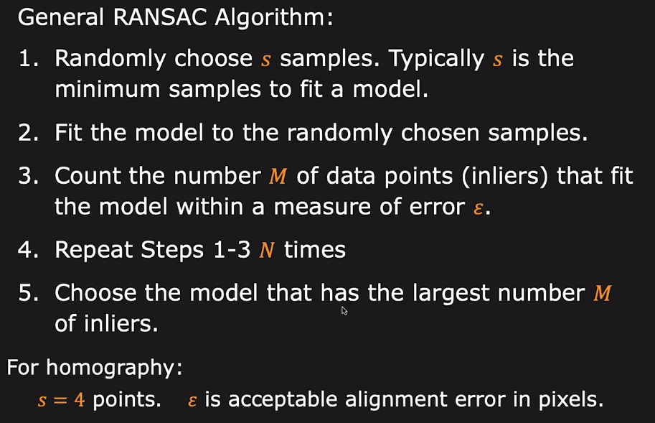
RANdom SAmple Consequences

Slide 20
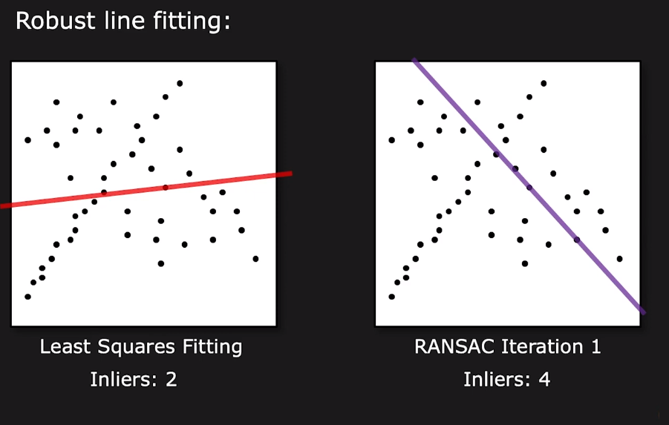
RANSAC Example: Line Fitting

Slide 21
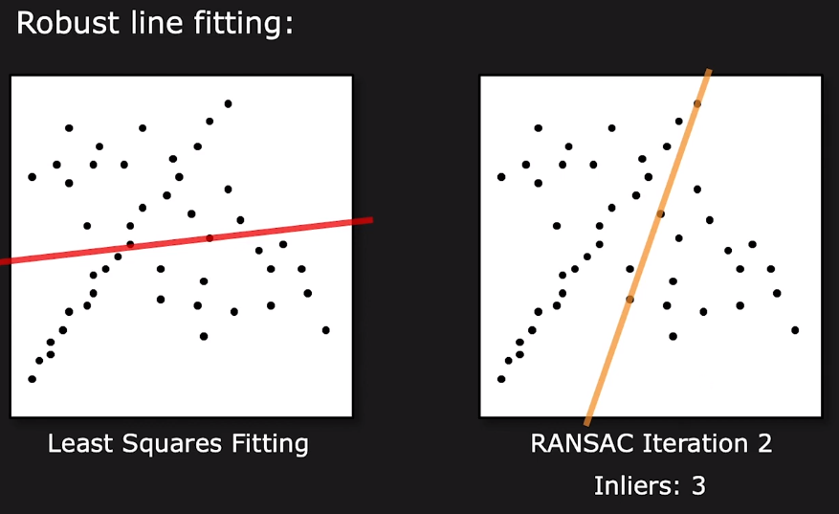
RANSAC Example: Line Fitting

Slide 22
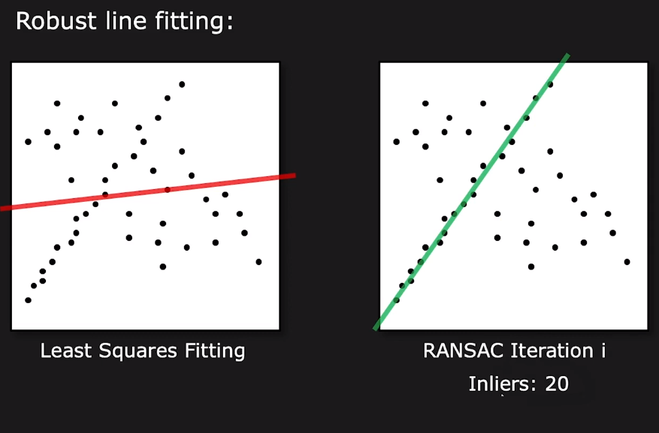
RANSAC Example: Line Fitting

Slide 23
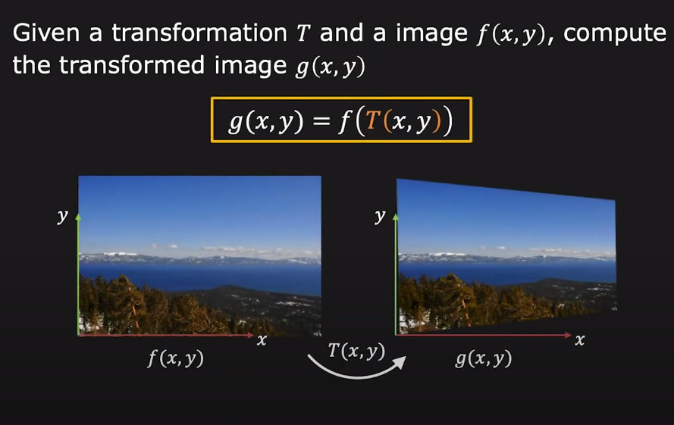
Warping Images

Slide 24
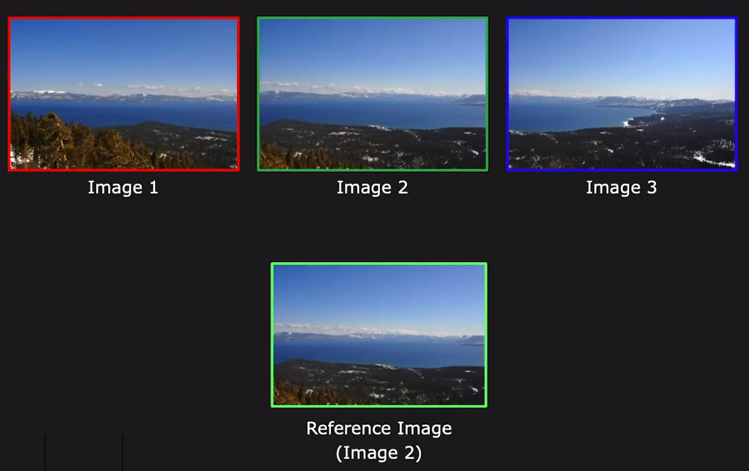
Image Alignment

Slide 25
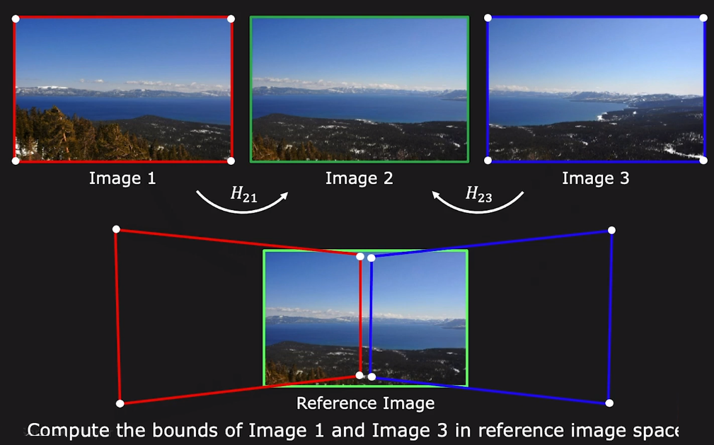
Image Alignment

Slide 26
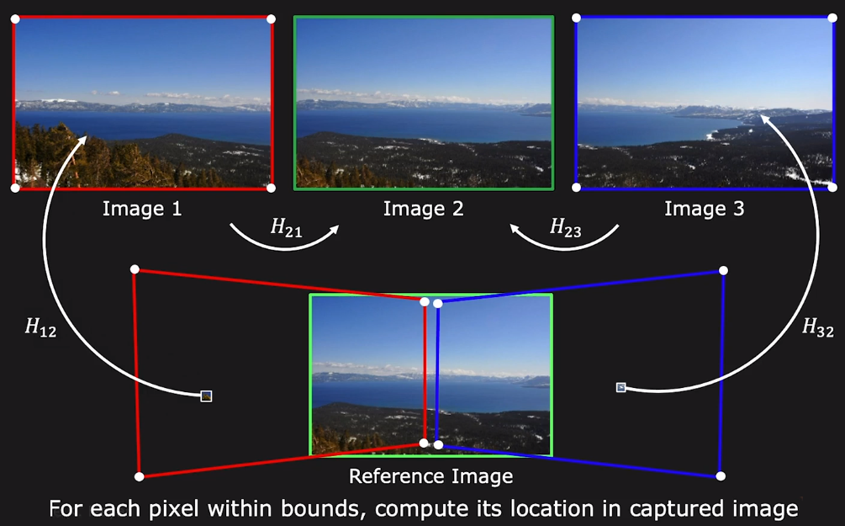
Image Alignment

Slide 27
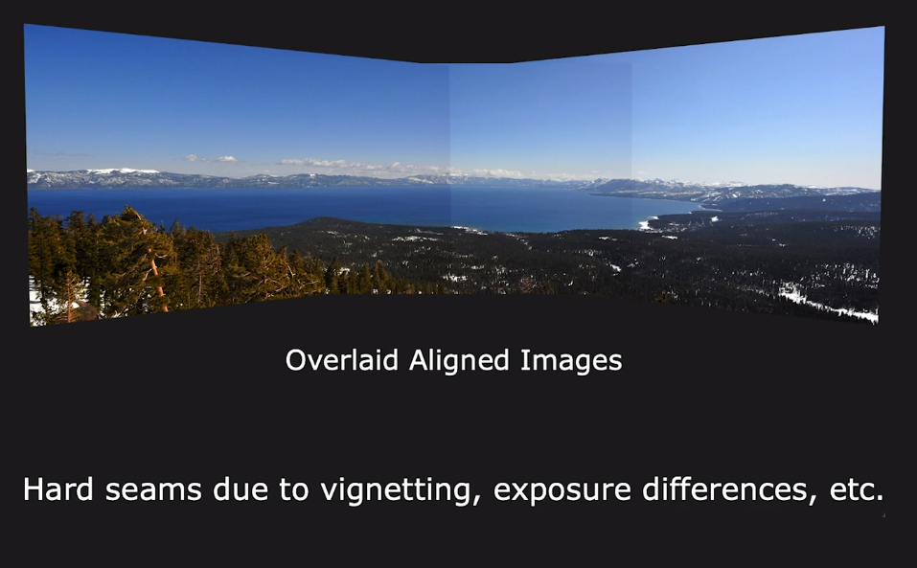
Blending Images

Slide 28
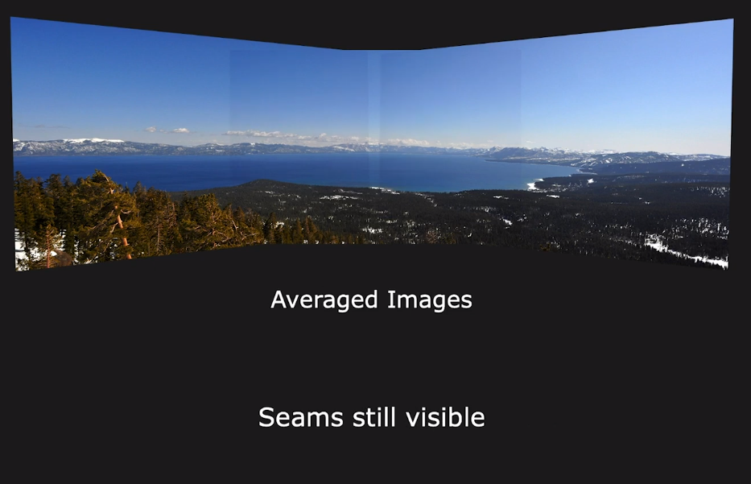
Blending Images: Averaging

Slide 29
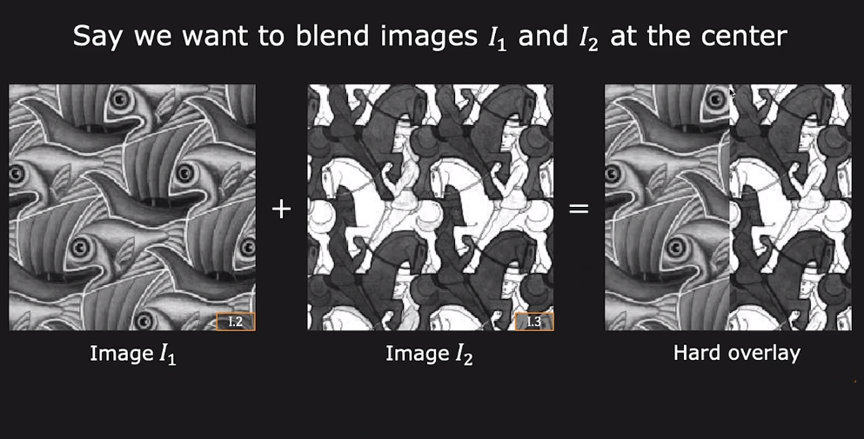
Blending Images

Slide 30
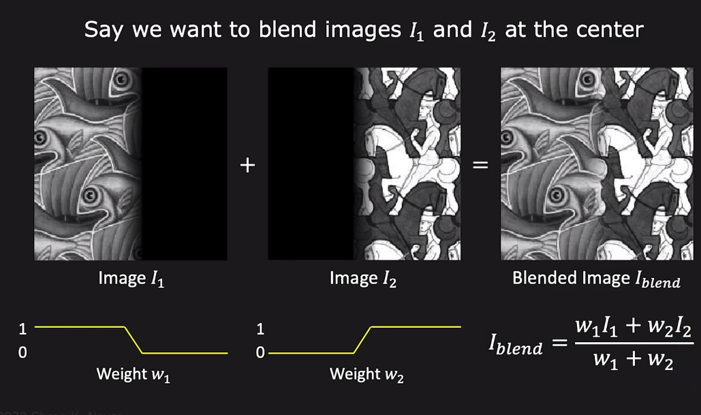
Blending Images: Weighted Blended

Slide 31
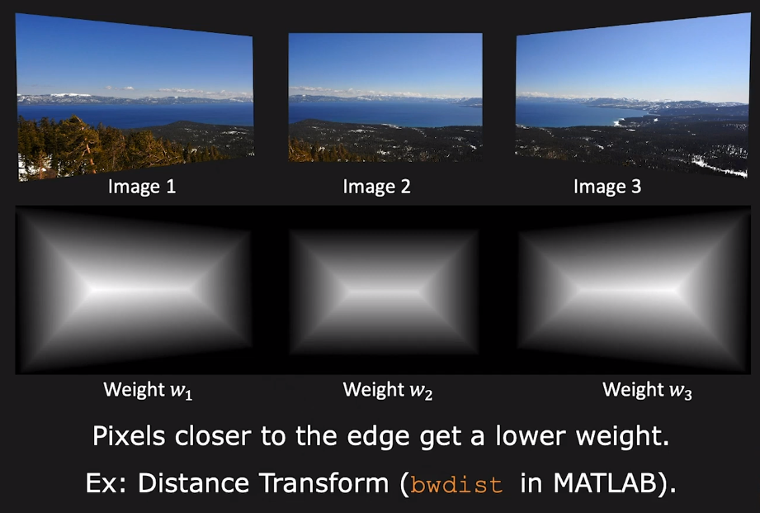
Blending Images: Weighted Blended

Slide 32
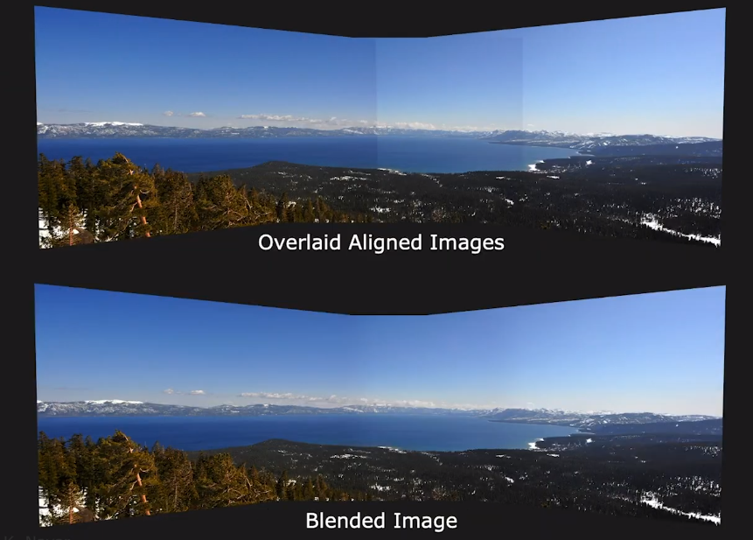
Blending Images: Weighted Blended

Slide 33
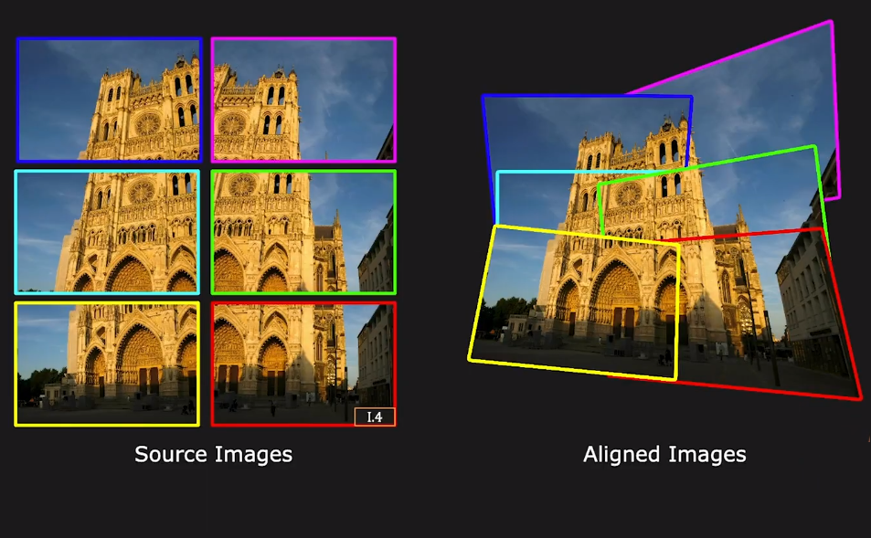
Image Stitching Example

Slide 34
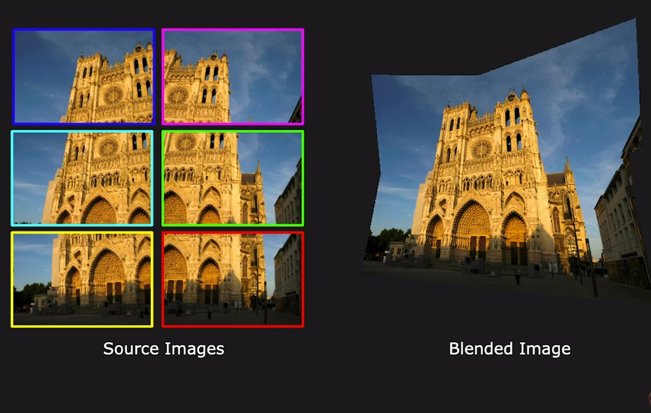
Image Stitching Example

Slide 35
Thanks

